Slide 1
Implementing Increased Transparency, and Reproducibility in Economics - The short version -
Lars Vilhuber
Cornell University
The opinions expressed in this talk are solely the authors, and do not represent the views of the U.S. Census Bureau, the American Economic Association, or any of the funding agencies.
Notes:
I am going to
Very briefly describe the background we are coming from
Make note of the various elements of progress (and the broader picture) of open science
Describe some of the ongoing challenges
Provide a glimpse of what is going to happen in economics, and maybe more broadly in the social sciences.

Slide 2
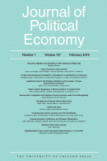
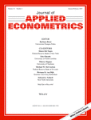


Progress
Replication archives and Data (Code) Availability policies
Since 1985 in economics
More broadly since early 2000s

Slide 3
Results?

Slide 4
Some key statistics
Study | Year | N | Success | Type | Type-R | Type-Data | Percent | Field
Dewald Thursby Anderson | 1986 | 54 | 2 | Complete | Reproducibility | Avail | 4% | Economics
Dewald Thursby Anderson | 1986 | 54 | 7 | Partial | Reproducibility | Avail | 13% | Economics
McCullough McGeary Harrison | 2006 | 186 | 14 | Complete | Reproducibility | All | 8% | Economics
McCullough McGeary Harrison | 2006 | 62 | 14 | Complete | Reproducibility | Avail | 23% | Economics
Nosek et al | 2015 | 100 | 36 | Complete | Replication |  | 36% | Psychology
Camerer et al | 2016 | 18 | 11 | Complete | Replication |  | 61% | Experimental Econ
Chang Li | 2017 | 67 | 22 | Complete | Reproducibility | Avail | 33% | Macroeconomics
Kingi et al | 2018 | 274 | 69 | Complete | Reproducibility | All | 25% | Economics
Kingi et al | 2018 | 162 | 69 | Complete | Reproducibility | Avail | 43% | Economics
Kingi et al | 2018 | 162 | 137 | Partial | Reproducibility | Avail | 85% | Economics
Kingi et al numbers are preliminary. Do not cite or quote.

Slide 5
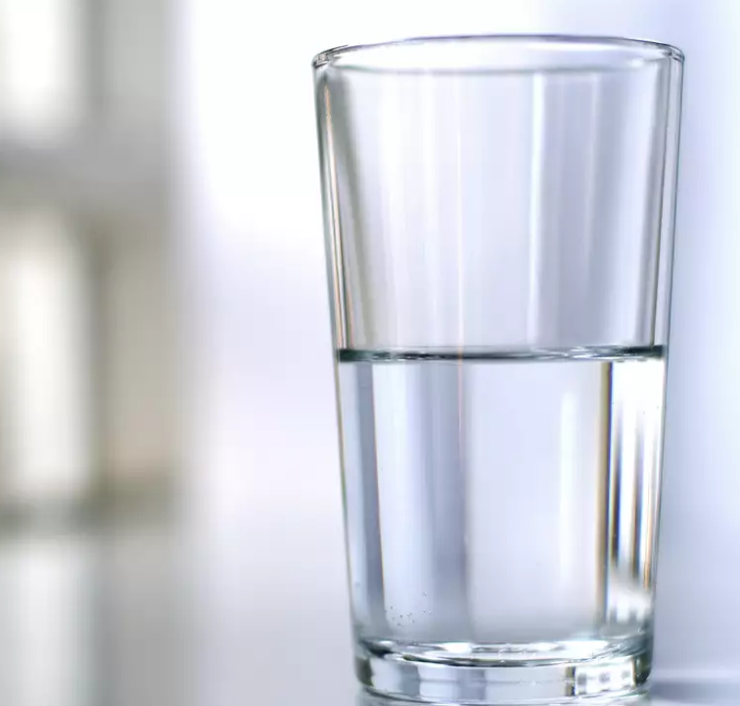
In a nutshell
40% use restricted-access data
25% use public-use data and are mostly or completely reproducible
25% use public-use data and are only partially reproducible
10% fail to yield useful results
It’s only ½ full!
Hey, it’s not empty!

Slide 6
Second round (2012-)
Greater enforcement of data (and code) availability
2015, AJ Political Science
2016, Data Editor for ASA Software Section
2016, Statistical review added Science
2017: AEA appoints Data Editor, with mandate to do similar activities (also EJ, Restud)

Slide 7

Action: Data citations and metadata
What is FAIR?
Findable,
Accessible,
Interoperable, and
Re-usable

Slide 8
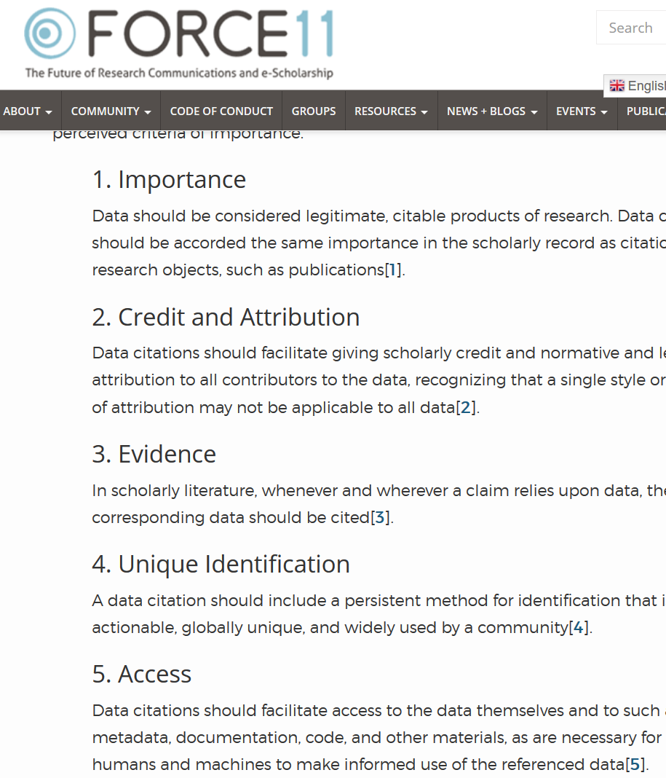

Starts with Data Citations
Data Citation Principles
Image of a standard data citation
Data Citation Synthesis Group: Joint Declaration of Data Citation Principles. Martone M. (ed.) San Diego CA: FORCE11; 2014 [https://www.force11.org/group/joint-declaration-data-citation-principles-final].

Slide 9
Evolving Journal and Data Infrastructure
Data Citations are not enough!

Slide 10
Why are data citations not enough?
They tell you “where”
But most do not
“who can access”
“for how long”
“under what conditions”
(Though in theory, these are covered by the Data Citation Principles)

Slide 11

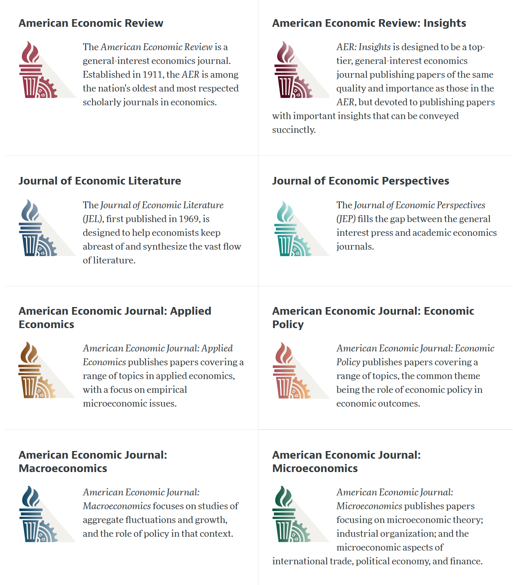

Slide 12
AEA “Data Availability Policy” (2018)
It is the policy of the American Economic Association to publish papers only if the data used in the analysis are clearly and precisely documented and are readily available to any researcher for purposes of replication.
Authors of accepted papers that contain empirical work, simulations, or experimental work must provide, prior to publication, the data, programs, and other details of the computations sufficient to permit replication. These will be posted on the AEA website. The Editor should be notified at the time of submission if the data used in a paper are proprietary or if, for some other reason, the requirements above cannot be met.

Slide 13
AEA Data Availability Policy (2018)
It is the policy of the American Economic Association to publish papers only if the data used in the analysis are clearly and precisely documented and are readily available to any researcher for purposes of replication.
Authors of accepted papers that contain empirical work, simulations, or experimental work must provide, prior to publication, the data, programs, and other details of the computations sufficient to permit replication. These will be posted on the AEA website. The Editor should be notified at the time of submission if the data used in a paper are proprietary or if, for some other reason, the requirements above cannot be met.

Slide 14
July 16, 2019

Slide 15
AEA Data & Code Availability Policy (2019)
It is the policy of the American Economic Association to publish papers only if the data used in the analysis are clearly and precisely documented and access to the data and code is clearly and precisely documented and is non-exclusive to the authors.
Authors of accepted papers that contain empirical work, simulations, or experimental work must provide, prior to acceptance, the data, programs, and other details of the computations sufficient to permit replication, as well as information about access to data and programs.

Slide 16
AEA DCAP (2018→2019)
These will be posted on the AEA website. The Editor should be notified at the time of submission if the data used in a paper are proprietary or if, for some other reason, the requirements above cannot be met.
Data and programs should be archived in the AEA Data and Code Repository. Authors will provide access to editors and reviewers, if requested, to both data and programs prior to acceptance. The Editor should be notified at the time of submission if access to the data used in a paper is restricted or limited, or if, for some other reason, the requirements above cannot be met. The AEA Data Editor will assess compliance with this policy, and will verify the accuracy of the information prior to acceptance by the Editor.

Slide 17
Current efforts at the AEA
Pre-emptively improve code archives
By conducting reproducibility checks when we can
By working with groups that conduct reproducibility checks when we cannot
Better archives
Greater transparency of the code and data archives
Better provenance tracking
Leave code where it is when appropriate
Leave data where it is almost always
Display that information
Notes:
Add logo from AEA

Slide 18
AEA Pre-Publication Verification
Every paper that receives a “conditional acceptance” is verified
Data citations
Quality of README
Quality of code
Reproducibility of code
Quality of metadata in the repository

Slide 19
Who is doing that?
Earlier reproducibility work: Flavio Stanchi (now at AirBnb), Sylverie Herbert (on the market), Hautahi Kingi (Impaq)
Current lead graduate students: David Wasser (until Dec 2019), Meredith Welch (since Jan 2020)
Current and past undergraduate students: Alexia Ge, Anthony Peraza, Craig Schulman, Elijah B. Ruiz, Gabriel Bond, Jason S. Katz, Jeong Hyun Lee, Jiayin Song, John Park, Joshua Passel, Kirubeal T. Wondimu, Linchen Zhang, Louis Liu, Luis Lopez Cabrera, Luke O’Leary, Mary-Jo Ajiduah, Naomi Li, Nicholas Swan, Nishat Peuly, Ryan Ali, Samuel Frey, Siyang (Elaine) Yu, Steve Yeh, Weilun Shi, William Hernandez, Yanyun (Iris) Chen, Yuan-Hsuan (Sharon) Lin, Zebang Xu, Xing Su, Jiazhen Tan , Xueshi Su, Vendela Norman, Anderson Park, Nehedin Juarez, Rubal Mistry, Syon Verma, William Silverman, Zechariah Karsana
Other graduate students: Aviv Caspi, Leah Kim

Slide 20
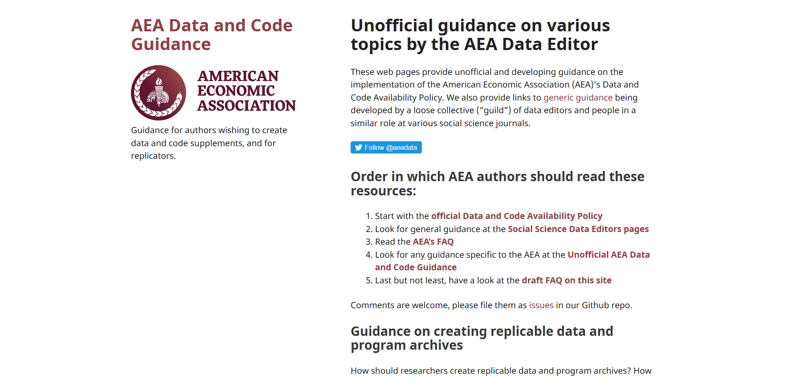

Slide 21
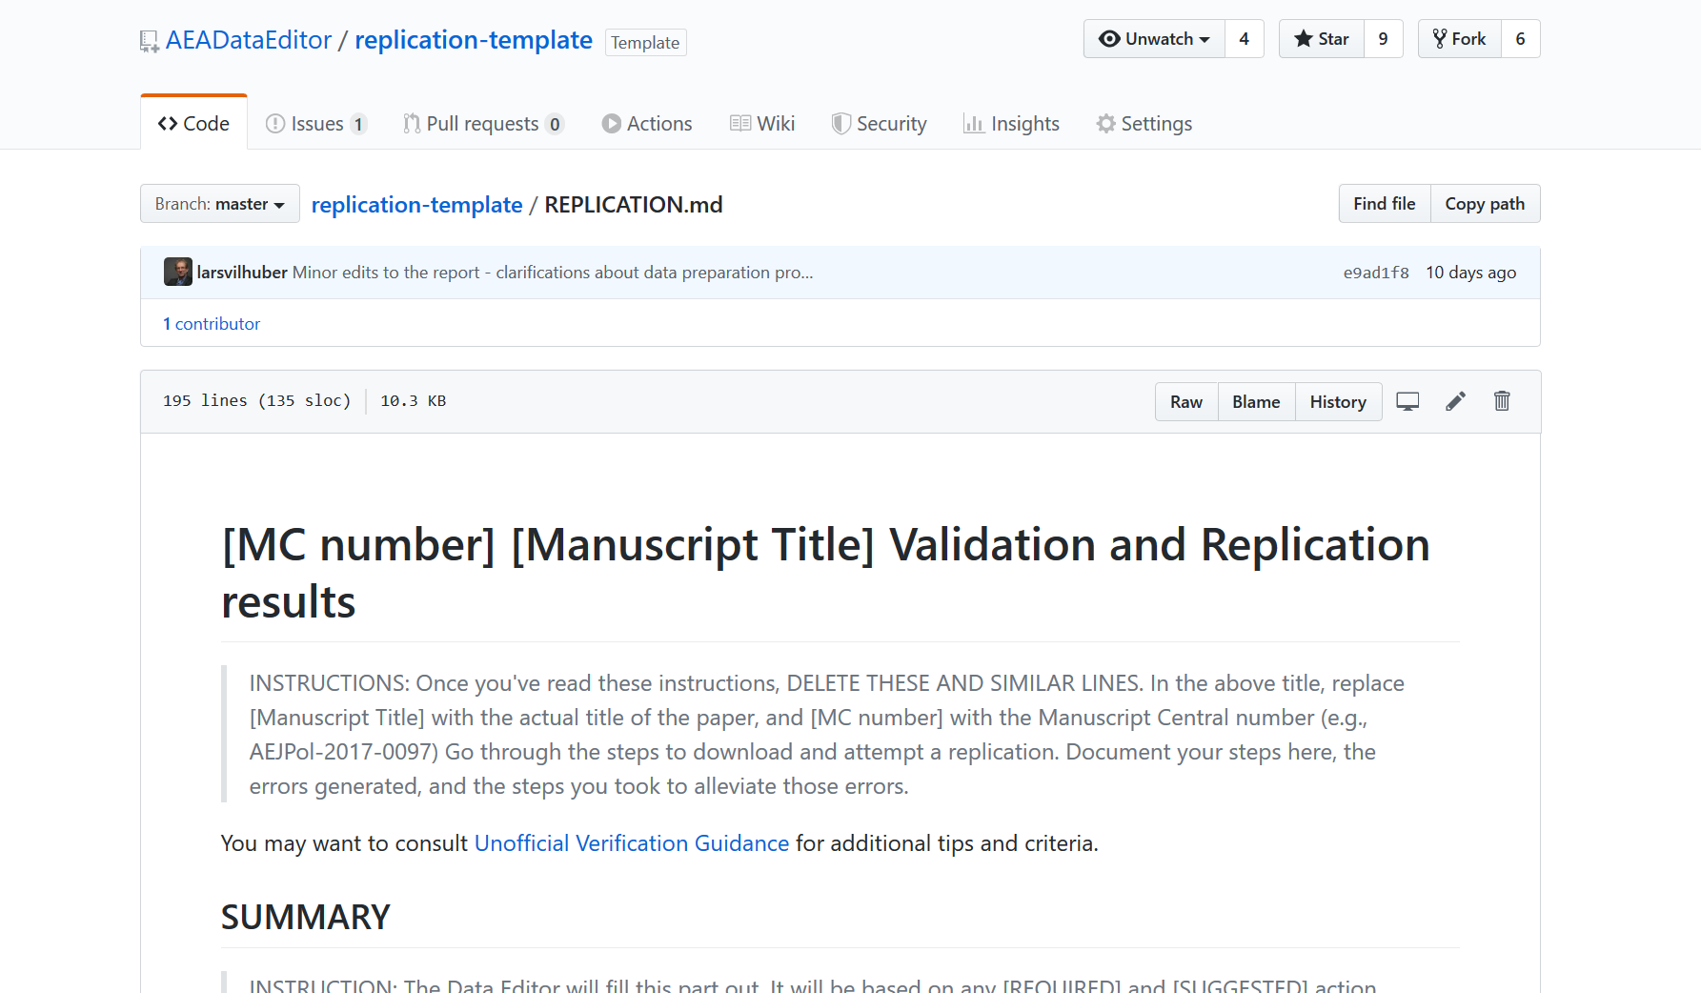

Slide 22
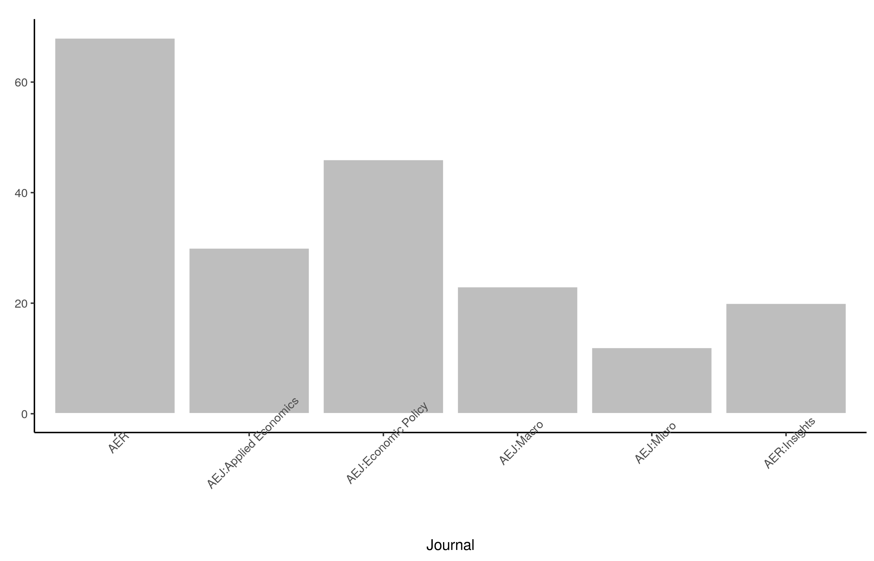
Stats on reproduced articles
Between July 16, 2019, and November 28, 2019 (4.5 mths), the AEA Data Editor team conducted
216 assessments
for 138 manuscripts.
(as of today, approx. 400)

Slide 23
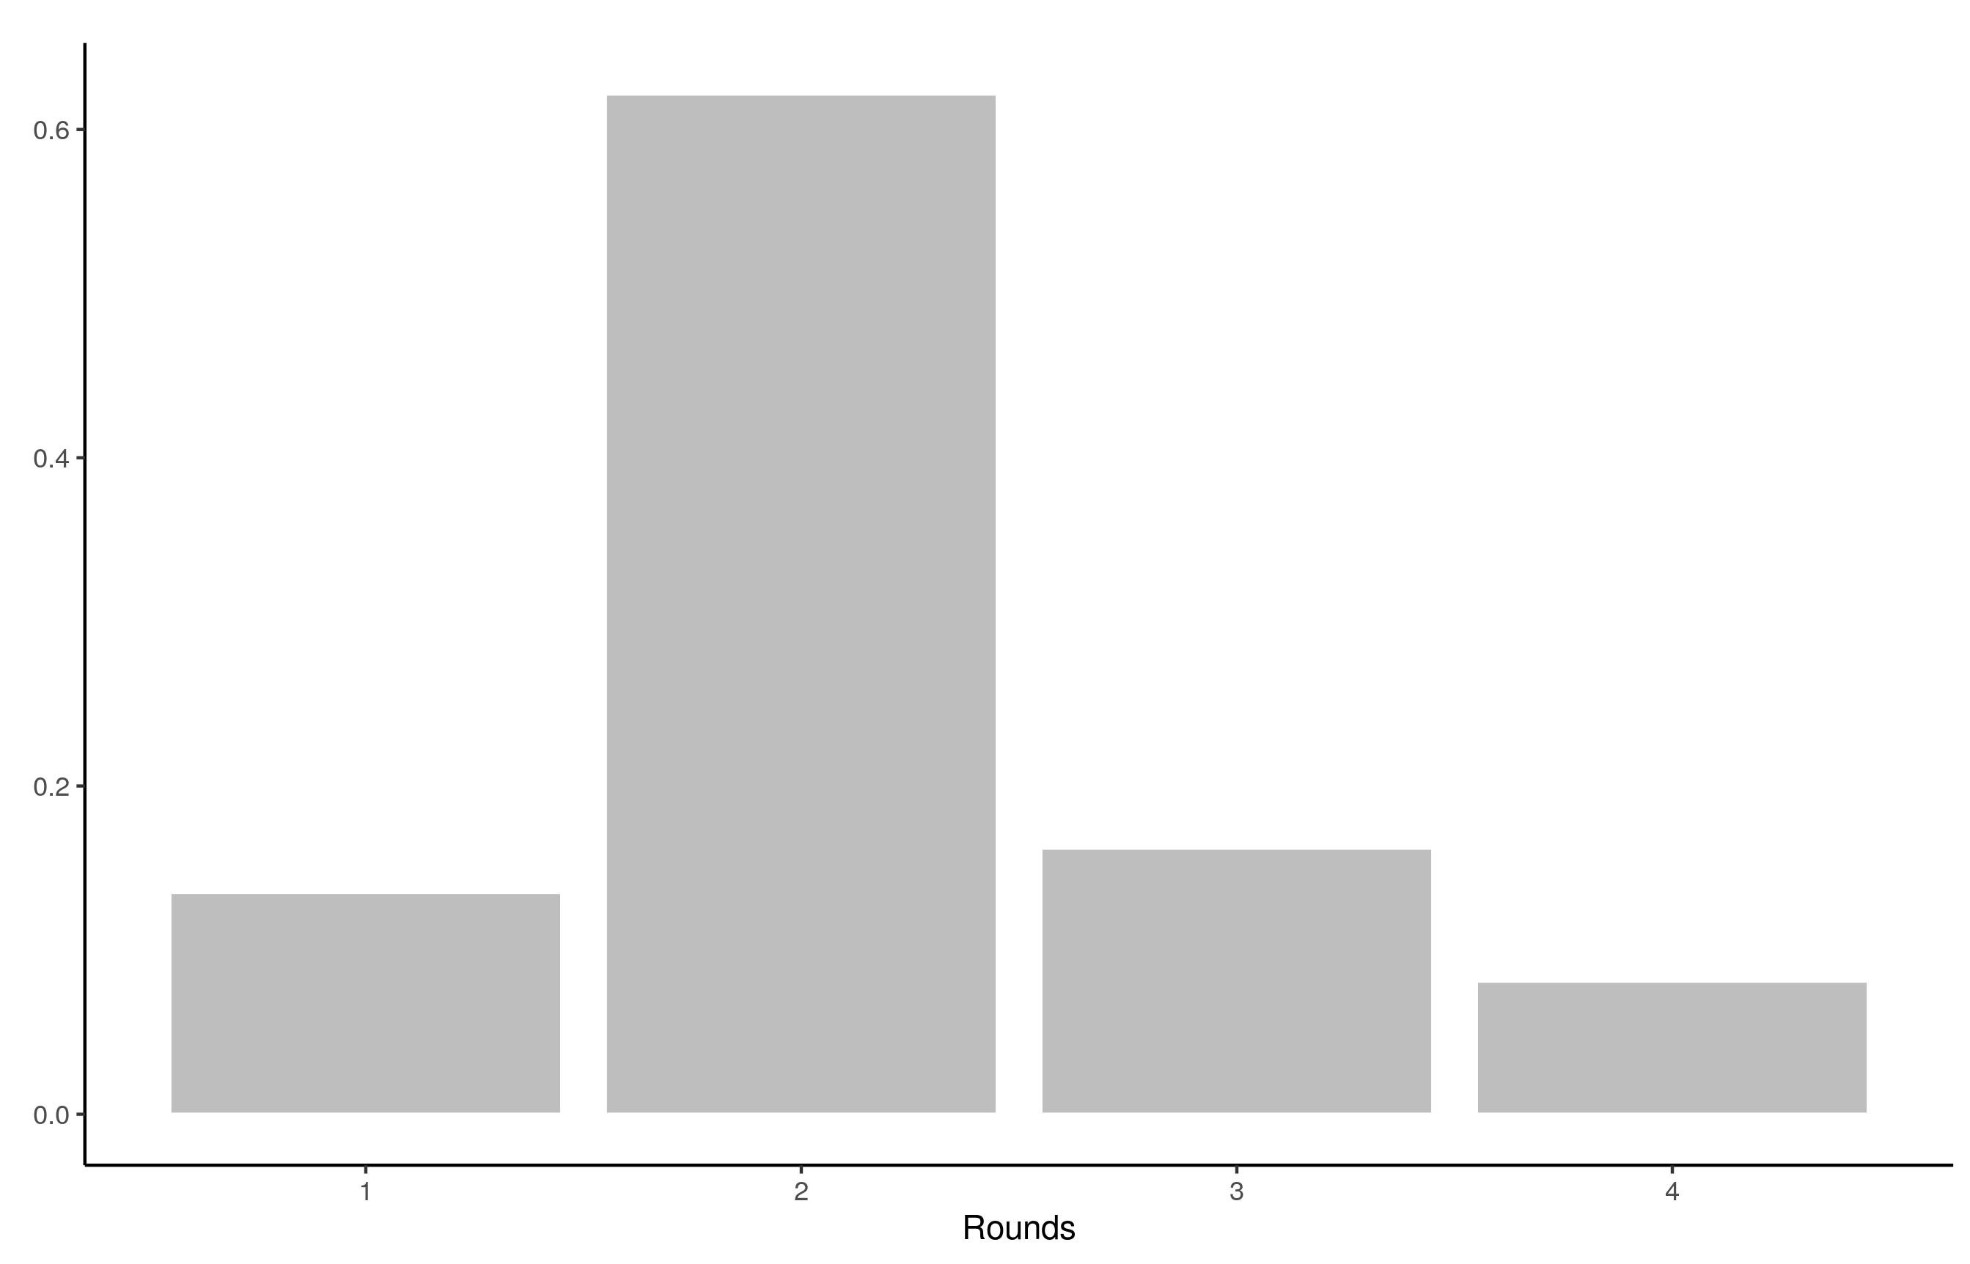
Stats on reproduced articles
The typical article goes through at least two rounds of assessment (none were perfect)

Slide 24
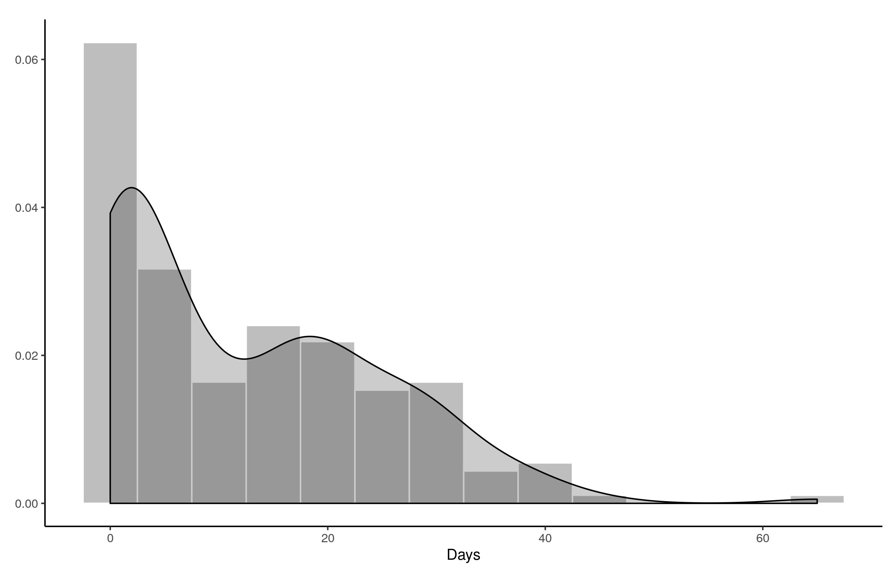
Stats on reproduced articles
Goal is turnaround of two weeks
Currently still too long

Slide 25
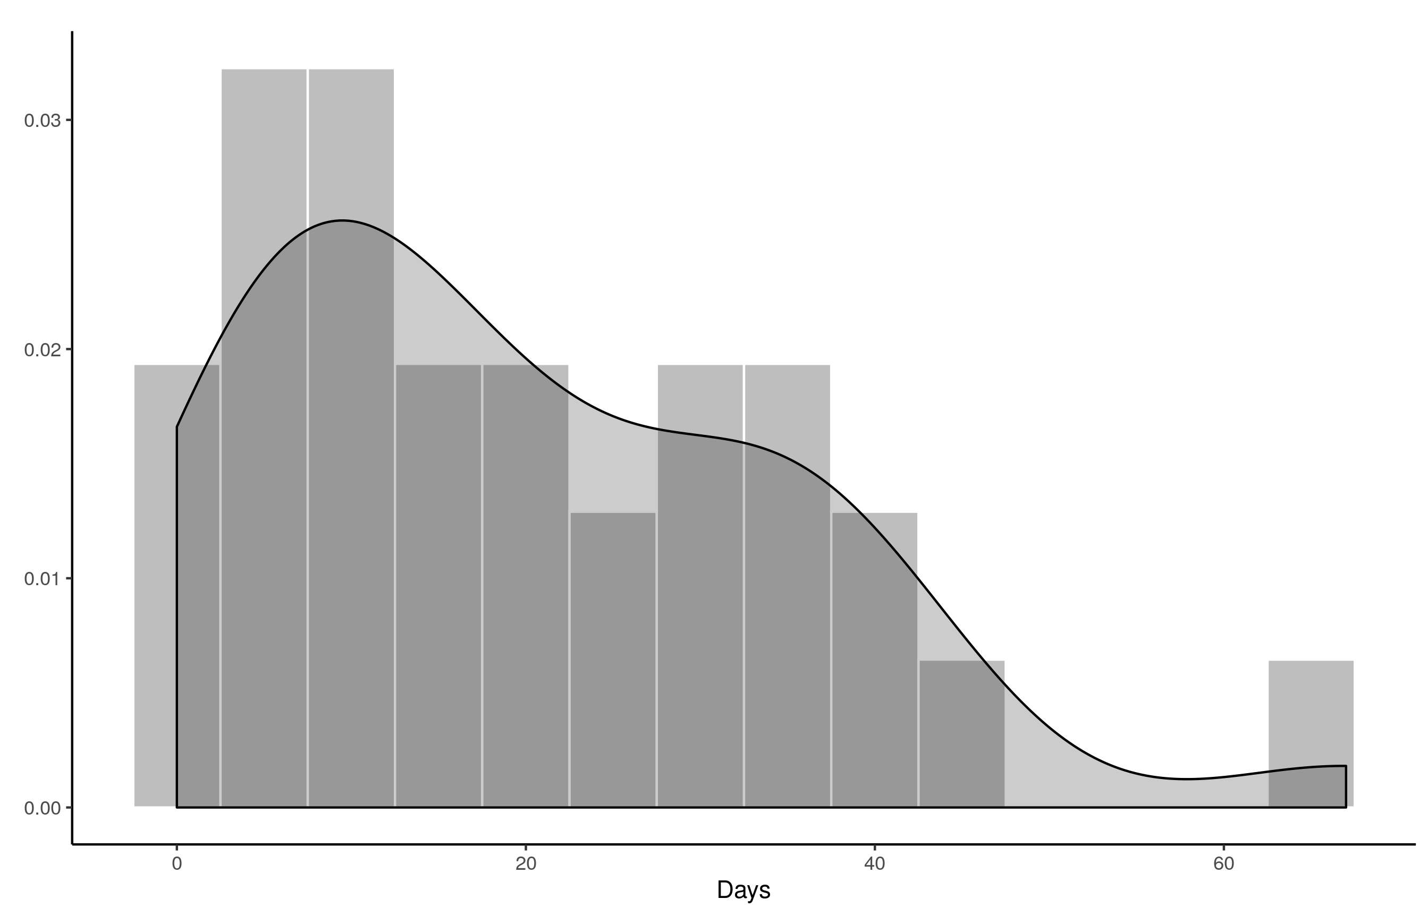
Stats on reproduced articles
But author response time is also a contributor

Slide 26
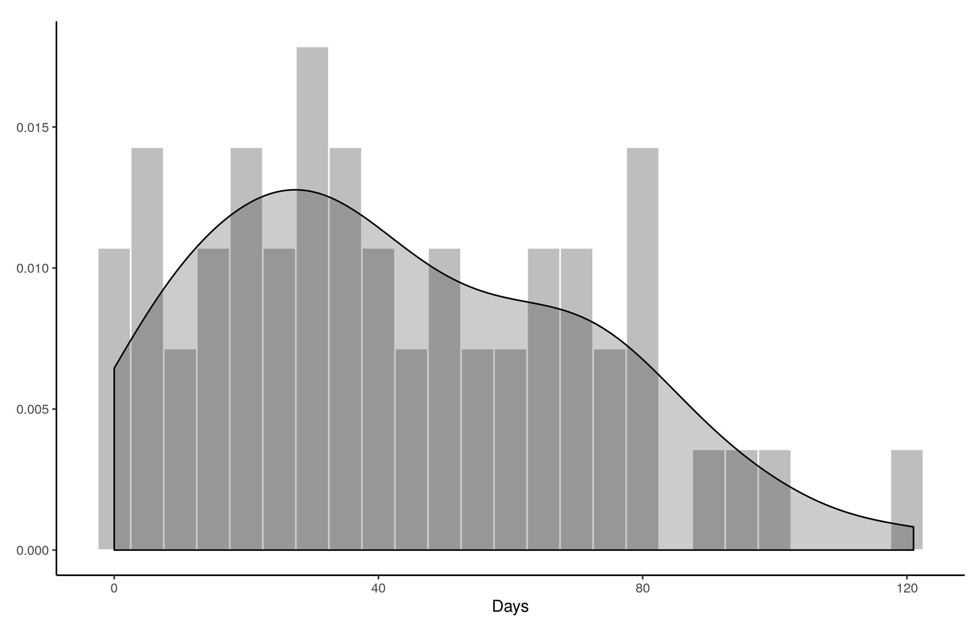
Stats on reproduced articles
Total time (from first submission to final signoff) is too long

Slide 27




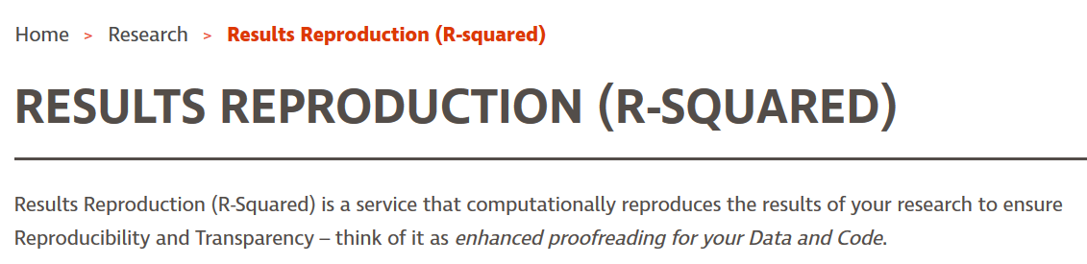
Increasing team size
Grown from 7 undergrads + 1 graduate assistant
To 14 undergraduates, 5 trainees, + 1 graduate assistant (+ 1 volunteer)
And:

Slide 28
Current efforts at the AEA
Pre-emptively improve code archives
By conducting reproducibility checks when we can
By working with groups that conduct reproducibility checks when we cannot
Better archives
Greater transparency of the code and data archives
Better provenance tracking
Leave code where it is when appropriate
Leave data where it is almost always
Display that information
Notes:
Add logo from AEA

Slide 29
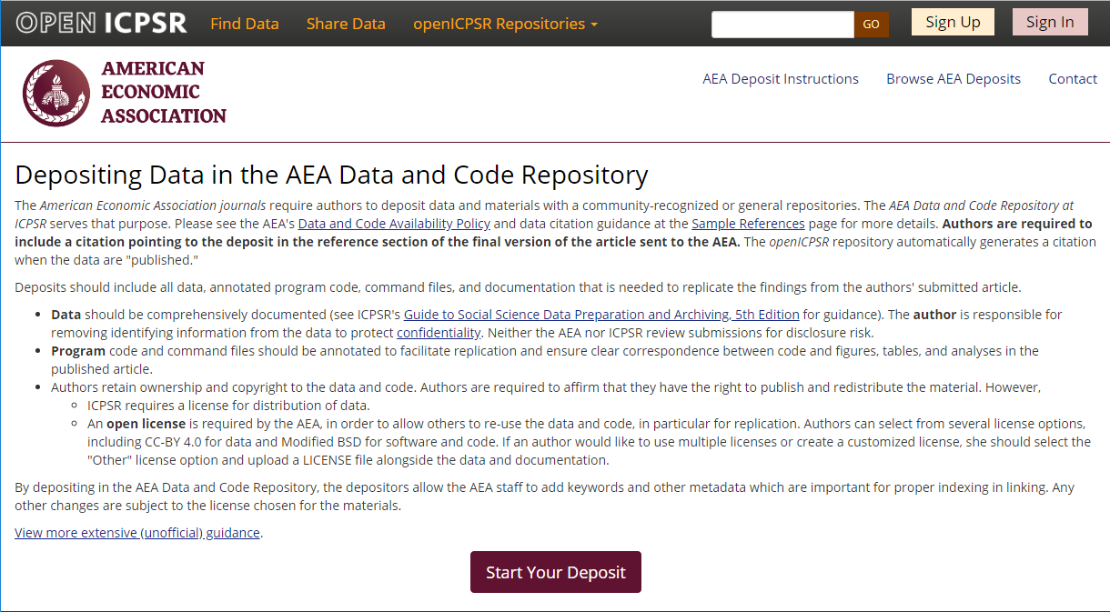
Full-featured repository

Slide 30
Migrating archives
Between Oct 11 and Oct 13, 2019, the staff at openICPSR ingested 2,552 historical AEA supplements, increasing the size of the openICPSR repository by a factor of 3.

Slide 31
Migrating archives
Between Oct 11 and Oct 13, 2019, the staff at openICPSR ingested 2,552 historical AEA supplements, increasing the size of the openICPSR repository by a factor of 3.
The migrated archives are now available through the openICPSR search interface, the general ICPSR search interface, as well as through a variety of federated search interfaces such as Google Dataset Search.

Slide 32
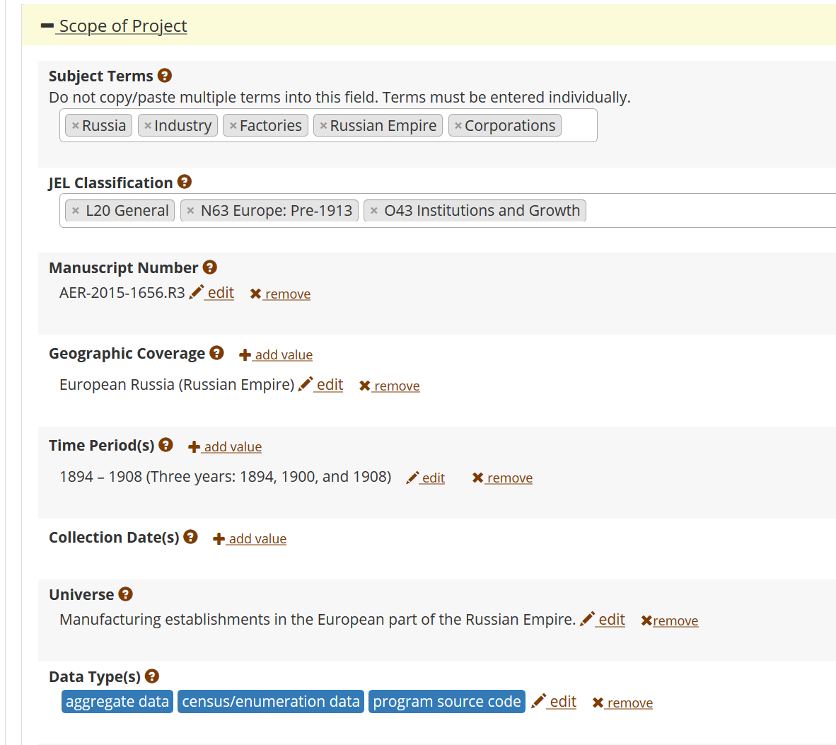
FAIR data principles rely on metadata
Notes:
Show metadata for this page

Slide 33
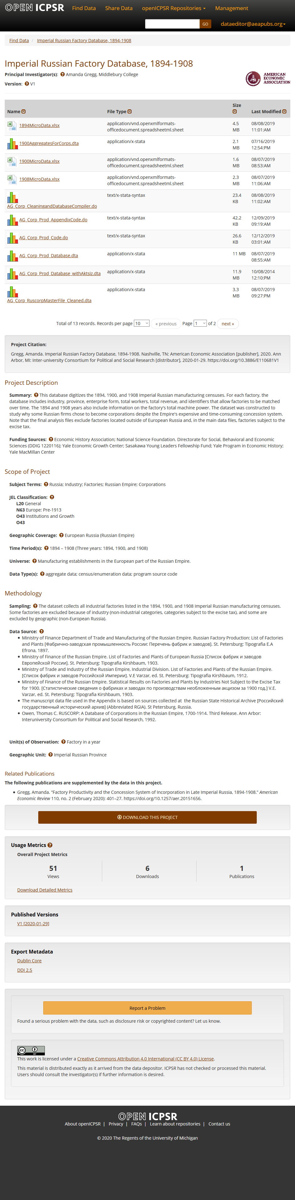
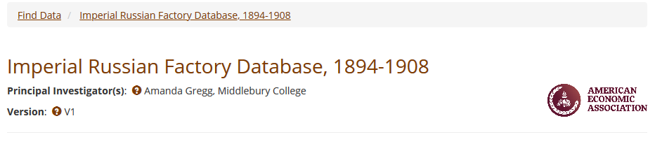
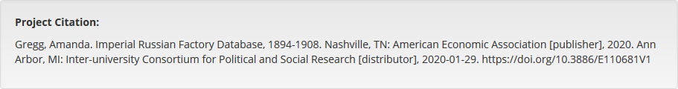
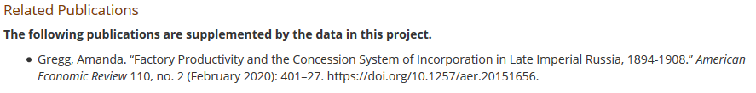

Slide 34
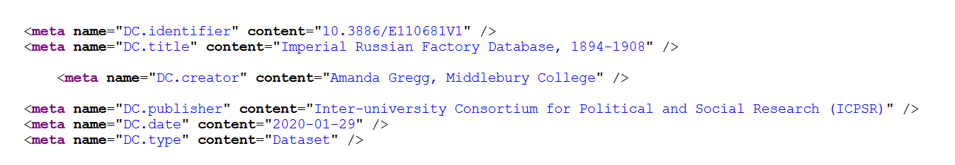

Slide 35
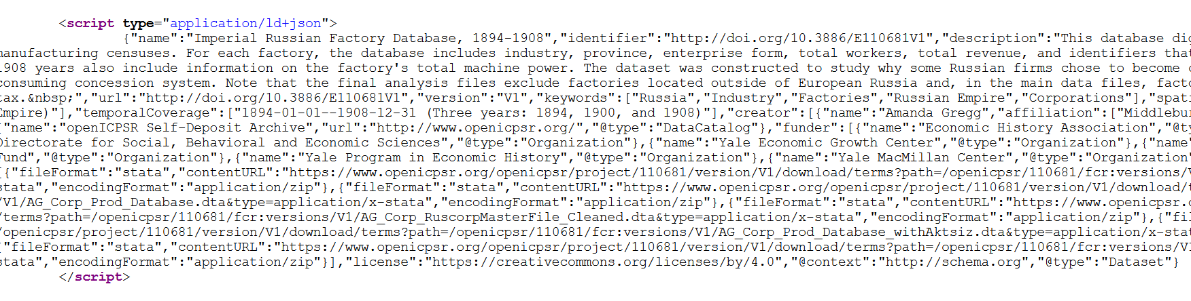

Slide 36
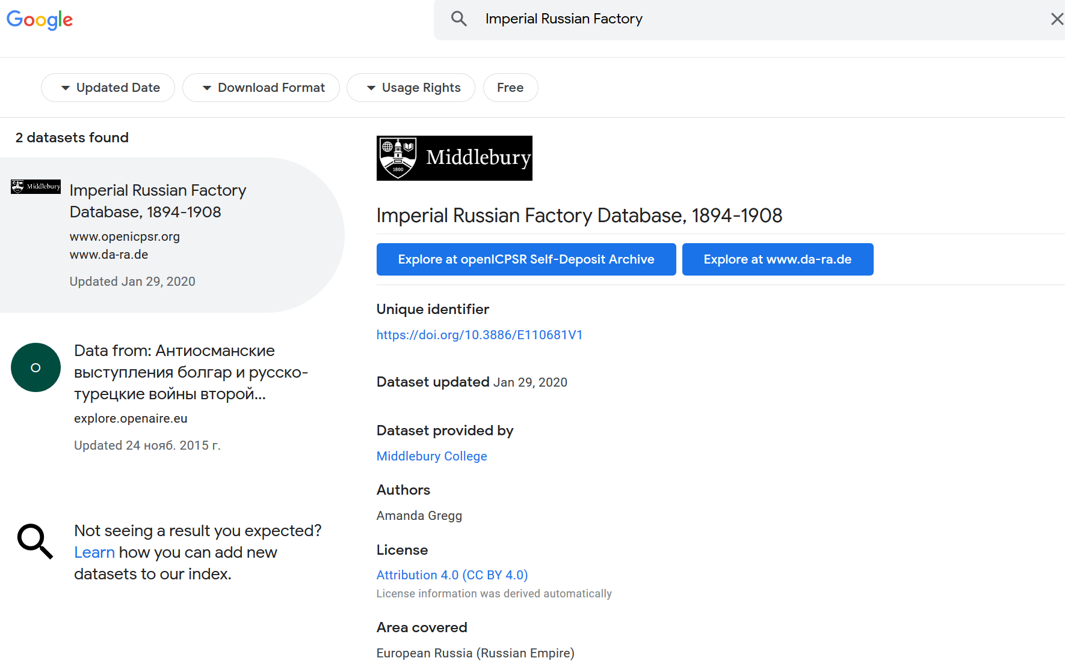
… and findability relies on metadata

Slide 37
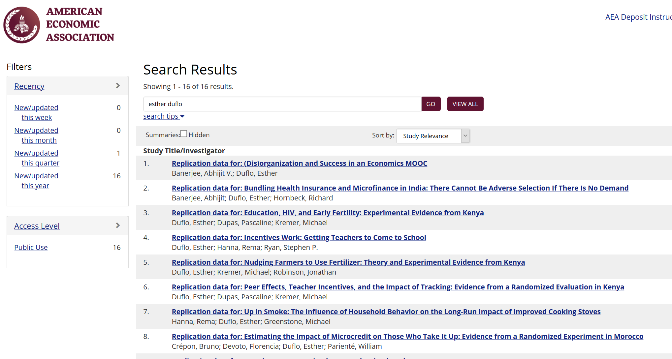

Slide 38
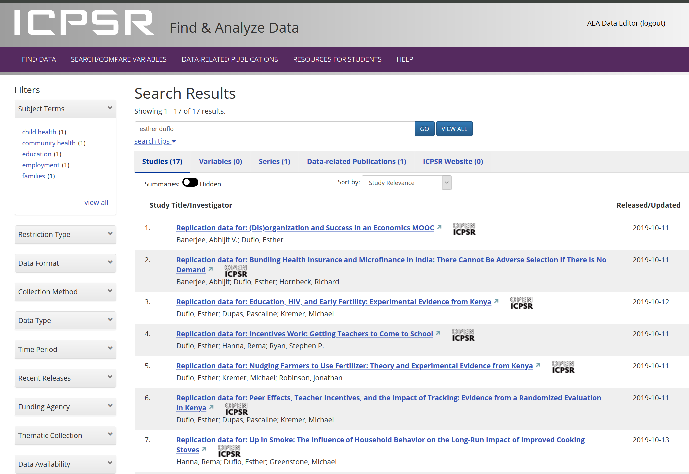

Slide 39
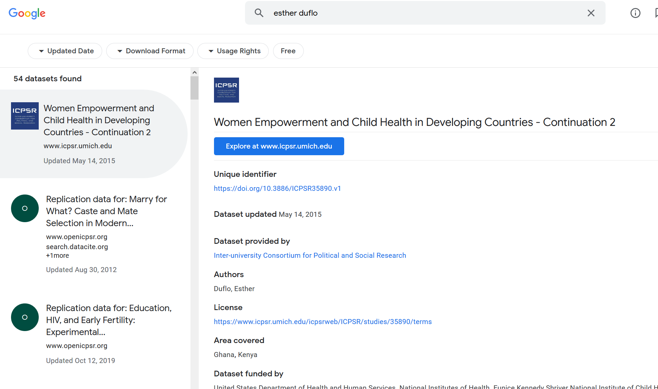

Slide 40
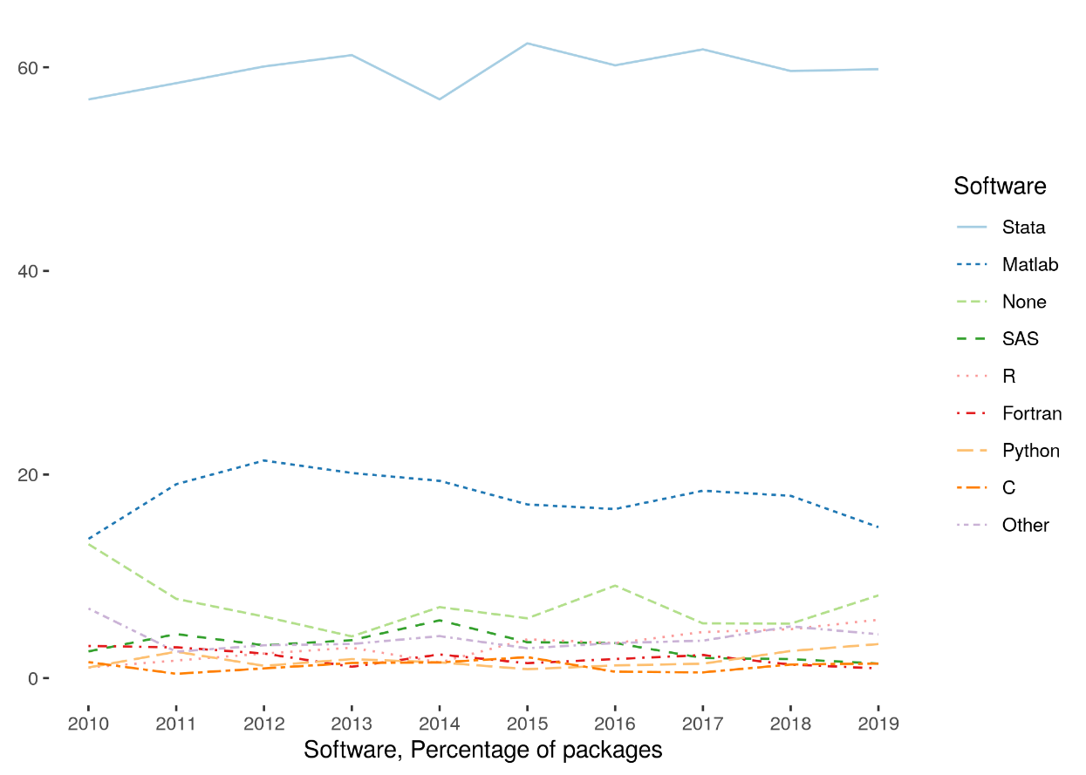
Some statistics
Stata is the most popular statistical software in the journals of the AEA (72.96% of all supplements)
followed by Matlab (22.45%)

Slide 41
Current efforts at the AEA
Pre-emptively improve code archives
By conducting reproducibility checks when we can
By working with groups that conduct reproducibility checks when we cannot
Better archives
Greater transparency of the code and data archives
Better provenance tracking
Leave code where it is when appropriate
Leave data where it is almost always
Display that information
Notes:
Add logo from AEA

Slide 42
Starts with Data Citations
Data Citation Principles
Image of a standard data citation
Data Citation Synthesis Group: Joint Declaration of Data Citation Principles. Martone M. (ed.) San Diego CA: FORCE11; 2014 [https://www.force11.org/group/joint-declaration-data-citation-principles-final].

Slide 43
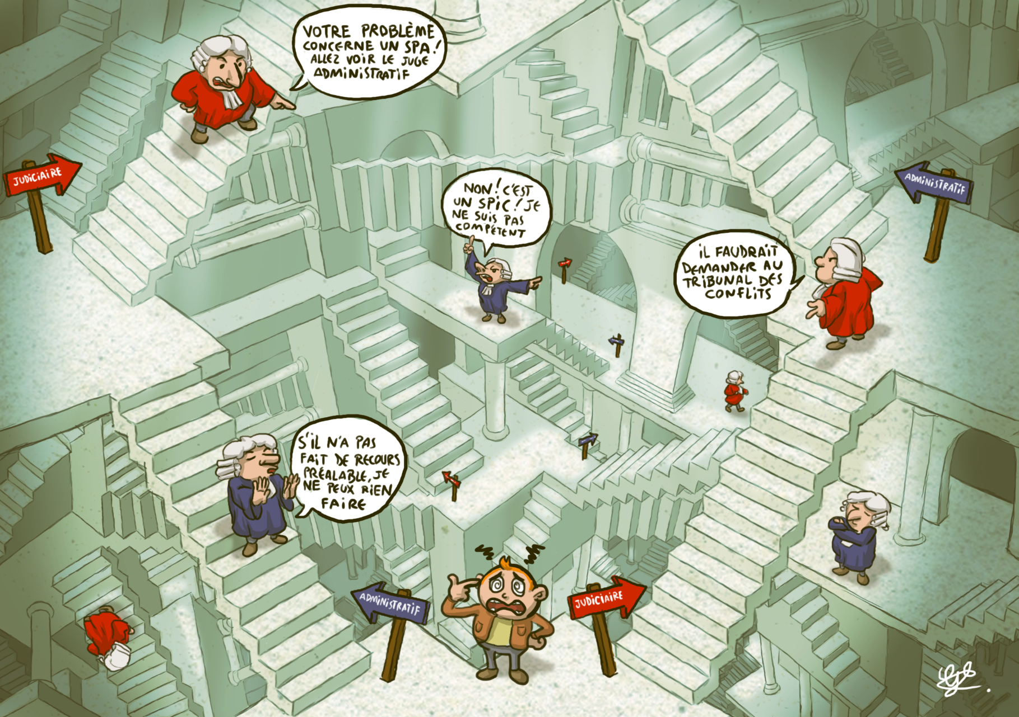
Every manuscript is checked
What datasets are used
Are they cited?
Is there additional information on access?
→ URL leads to exact data?
→ URL leads to application procedure?
→ other access procedure is described?
Le labyrinthe des juges, par Guillaume Beck

Slide 44
Every manuscript is checked
What datasets are used
Are they cited?
Is there additional information on access?
Is there license/ data use information?
→ Should the author provide the data?
→ Is the author allowed to provide data?

Slide 45

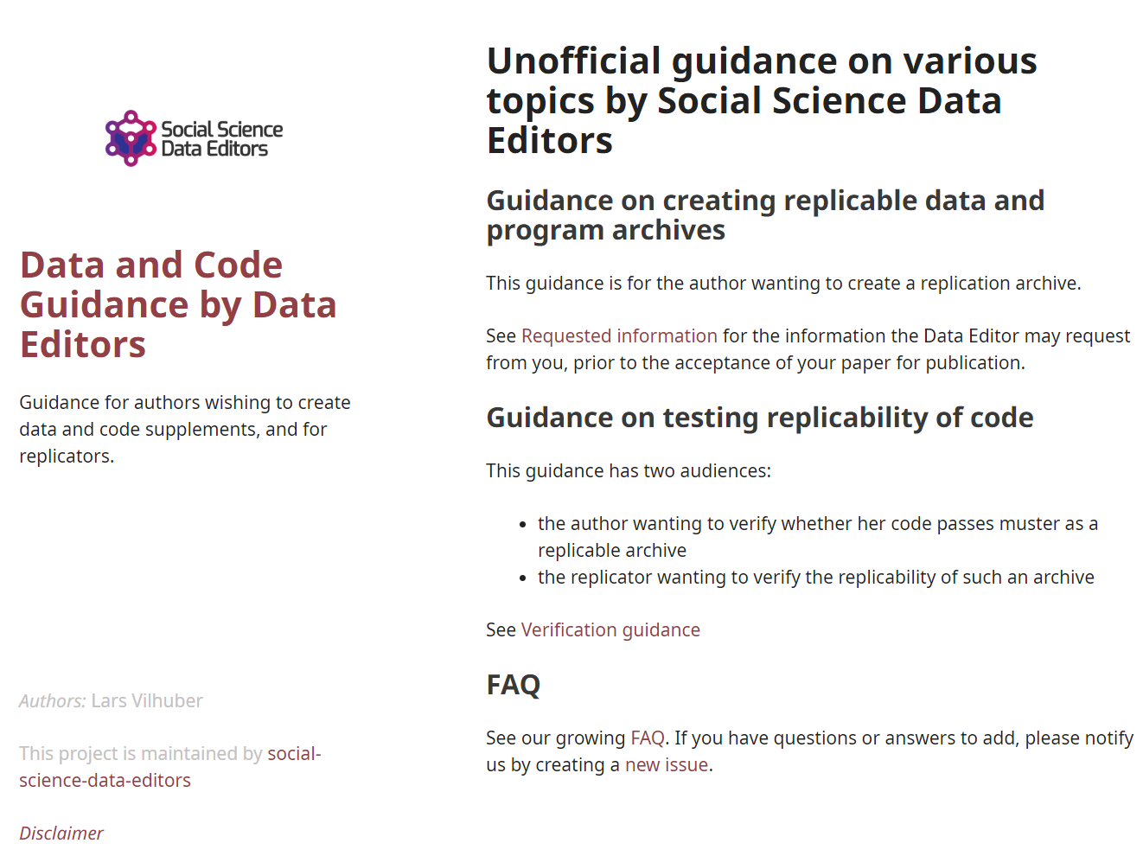
Social science “guild”
https:// social-science -data-editors. github.io/ guidance/

Slide 46
Thank you!
DOI: to come

Slide 47
Extra slides

Slide 48
Evolving Journal and Data Infrastructure
Data Publishers struggle with this!

Slide 49
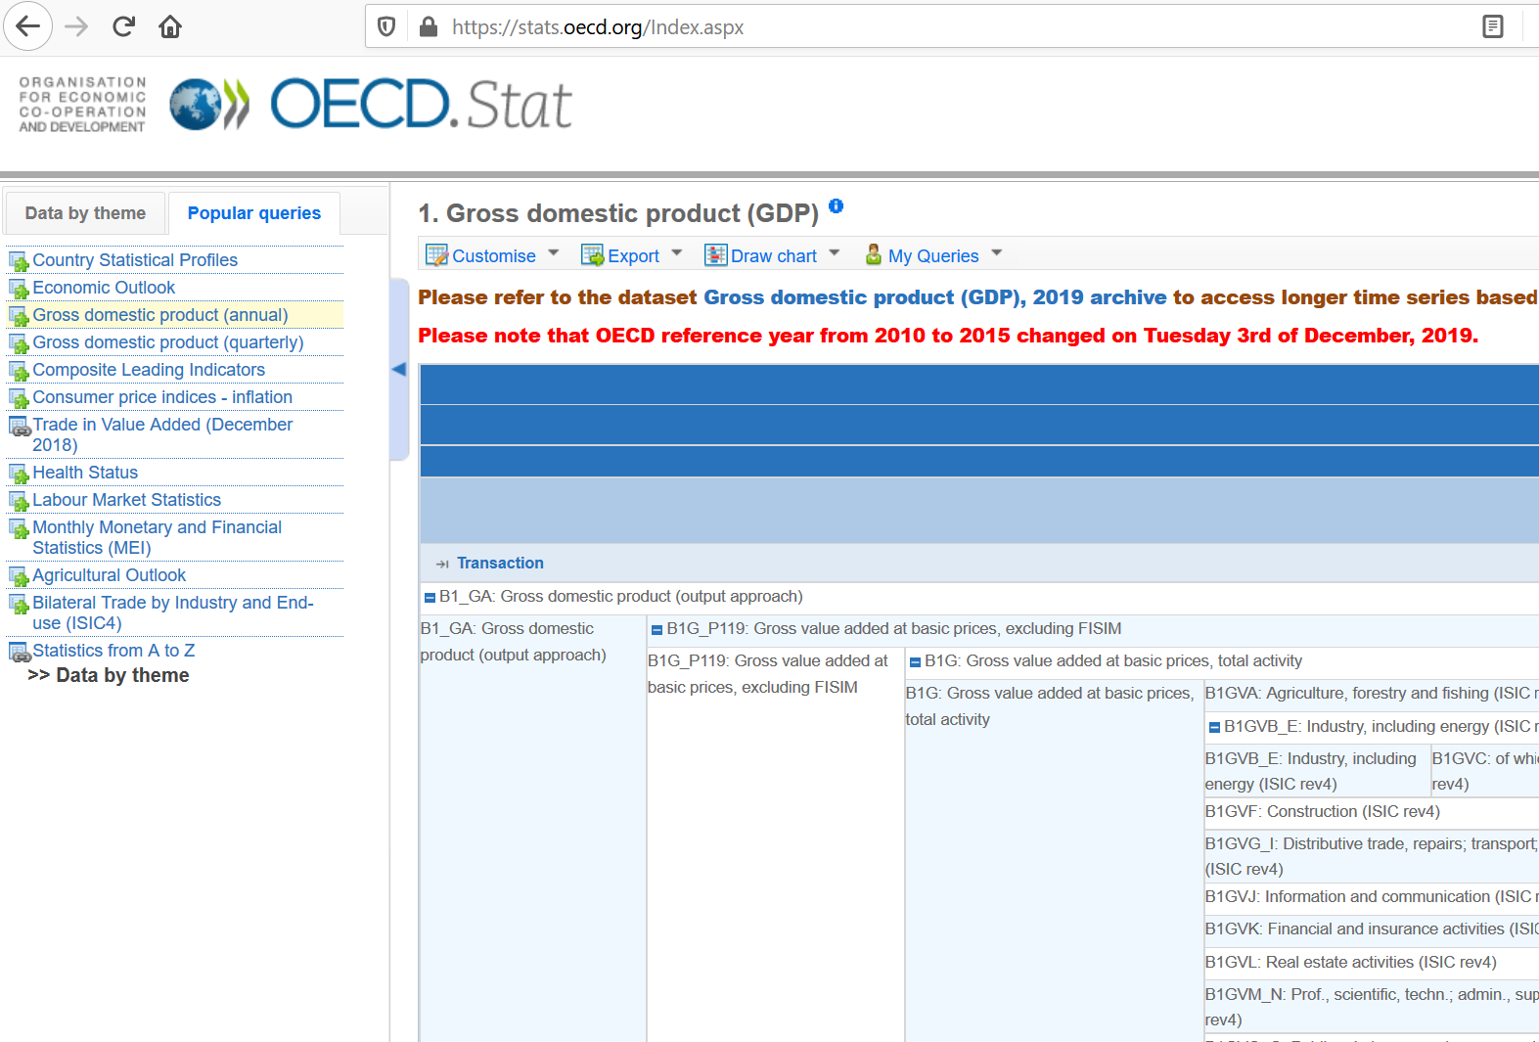
Example 1: OECD
URL does not always change!
(but sometimes it does)

Slide 50
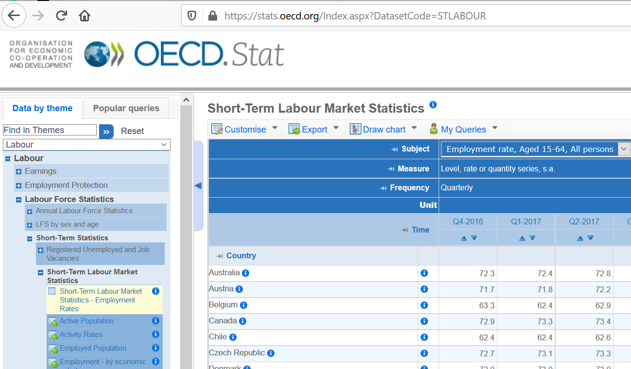
Example 1: OECD
URL does not always change!
(but sometimes it does)

Slide 51
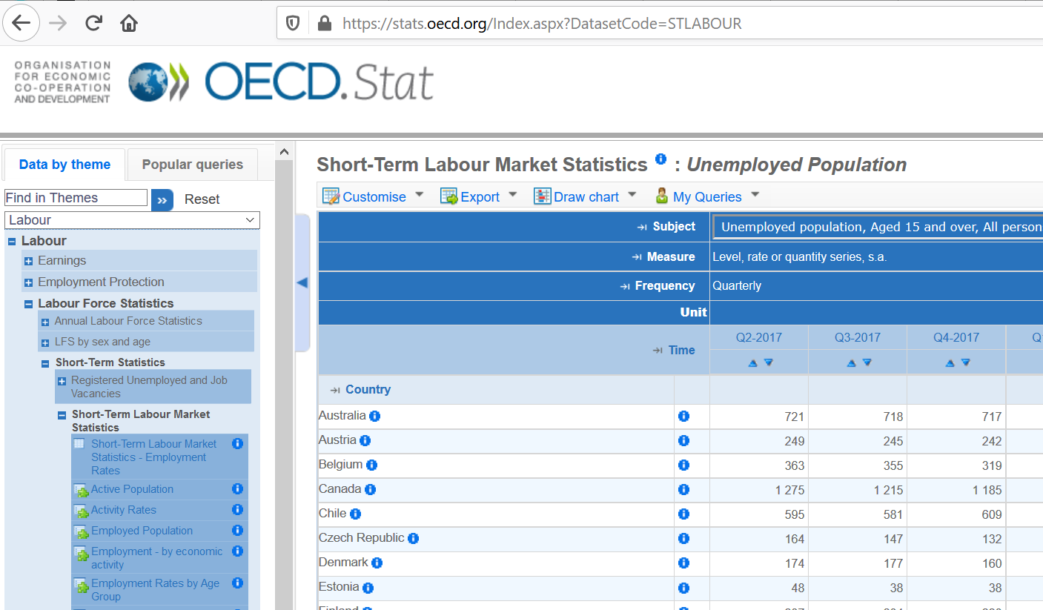
Example 1: OECD
URL does not always change!
(and then it doesn’t…)

Slide 52
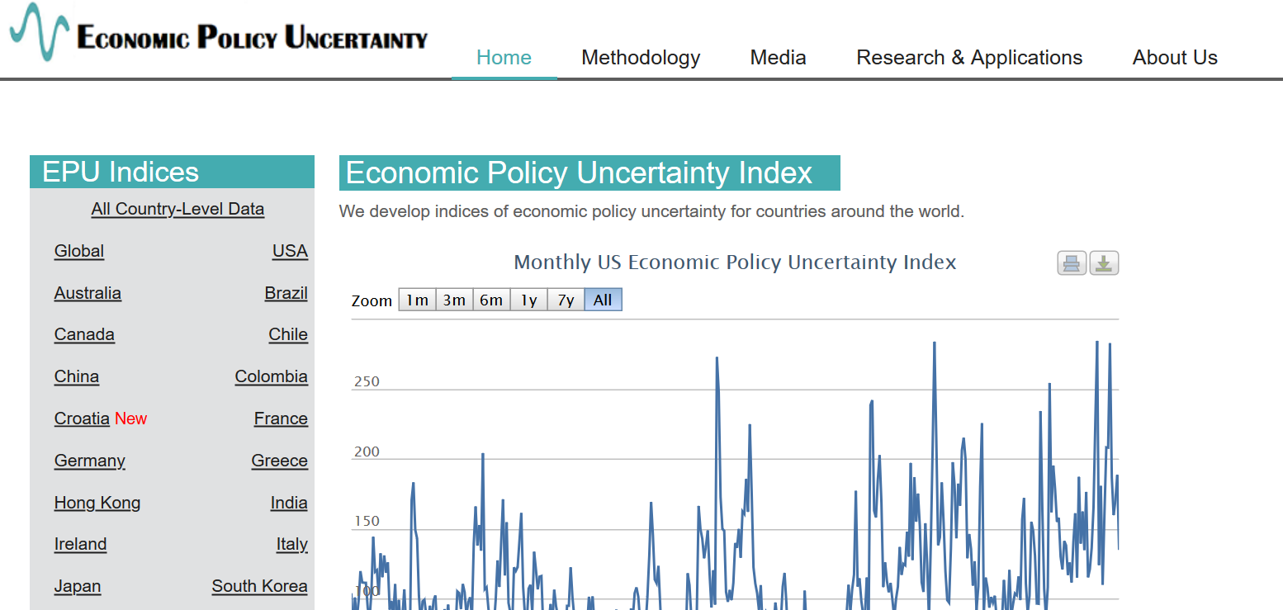
Example 2: Academic data publisher

Slide 53

Example 2: Academic data publisher

Slide 54

Example 2: Academic data publisher-new!

Slide 55
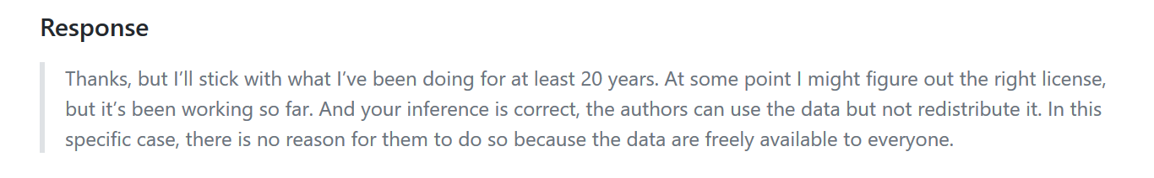
Notes:
Not the same provider!

Slide 56
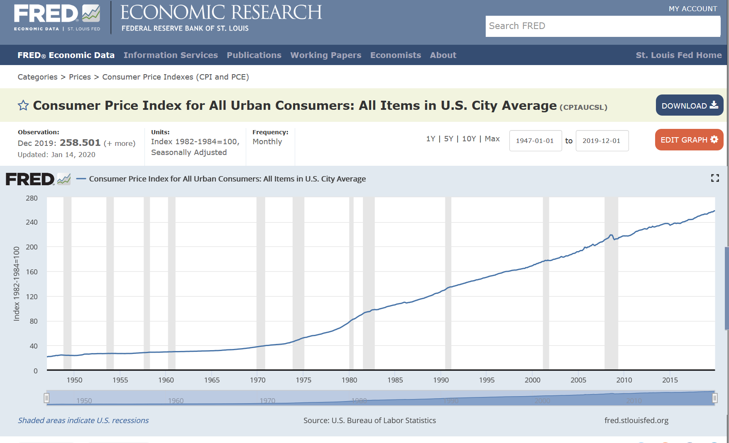
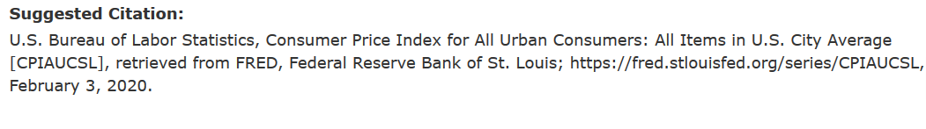
Example 3: FRED (St. Louis Fed)

Slide 57
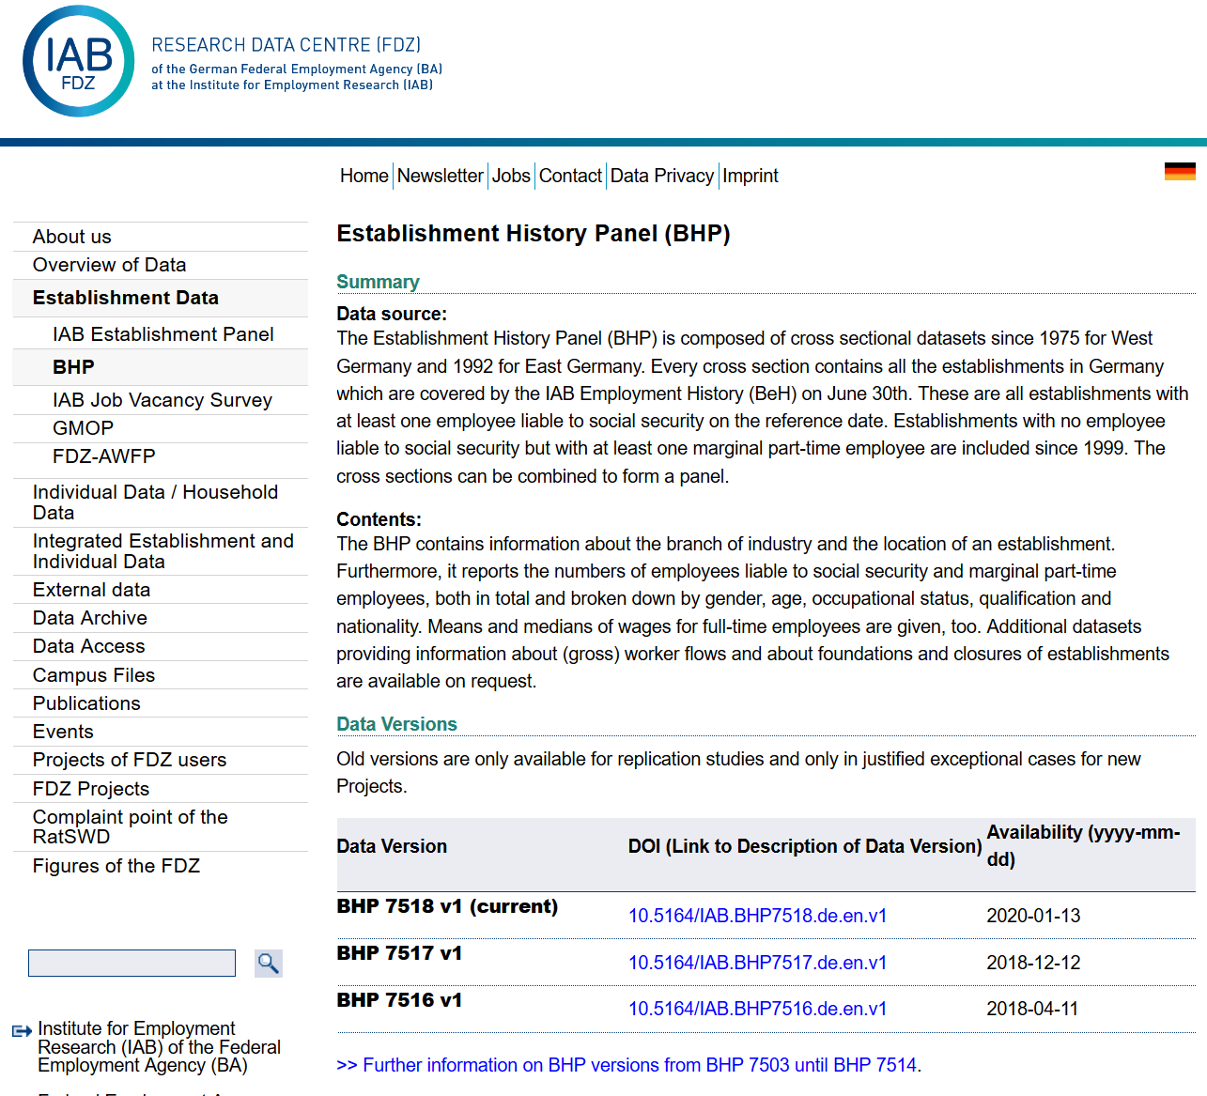
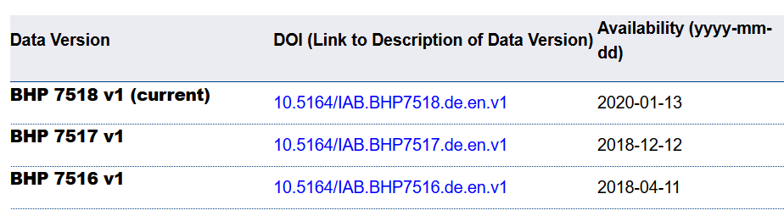
Example 4: German Restricted-access

Slide 58
Example 4: German Restricted-access

Slide 59

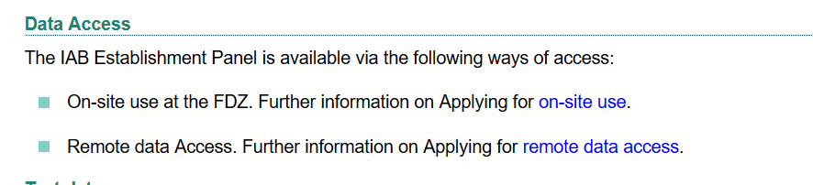
Example 4: German Restricted-access

